Slide 1
Instructions
Common
Colors : Black, Gray, White, Gold, Coral, Purple only
Font Size: 3 size consistency only,
Body text size
Heading text size(Bigger)
Design element -Text size(biggest not everywhere)
Roundness of card: (Example given)
Size of card : As of now it is not fitting rightly in my laptop window or mobile completely (big, please provide some spaces) (although I check some other website they are still big in order to make the readability of text right, so please optimize accordingly)
H x W of cards (I want more height than width in most cases, except in featured part and text only cards)
Spaces are required at many places in between
Headers (as of now are nice, no need to change size)
Keep the card row consistence of 3X except where highlighting on top

Slide 2
Navigation Panel
Notes (common header)
Combined
1. Future
2. Challenges
3. Movements
Gigs
Portfolio (common header)
1. Start-ups
2. Patents
3. Supplies(blank)
4. Projects(blank)
H&T (Headlines & Timelines)
NEWS
Calendar
Team (common header)
Core Team (landing)
Advisors
Strategic Partners
Another Navigation like team
Another Navigation (correctly made)
Another Navigation (correctly made)

Slide 3
Social media
Get the Links from WALEI.org
Instagram: walei_official

Slide 4

Footer
We only have Email, LinkedIn and Instagram
Simple Footer as example given below

Slide 5
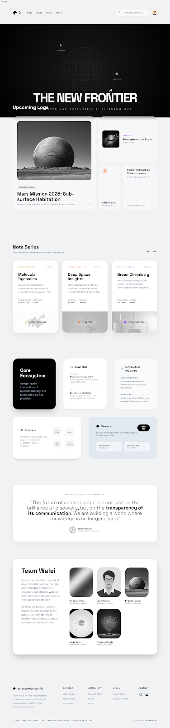

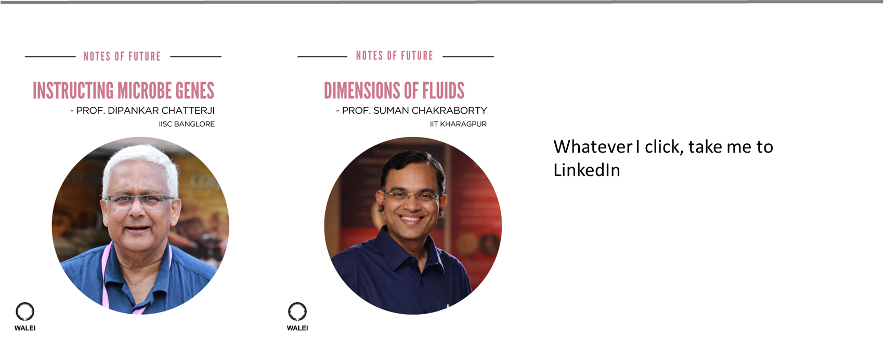
Landing page
Landing page
Notes of Future
Notes of Challenges
Notes of Movements

Slide 6
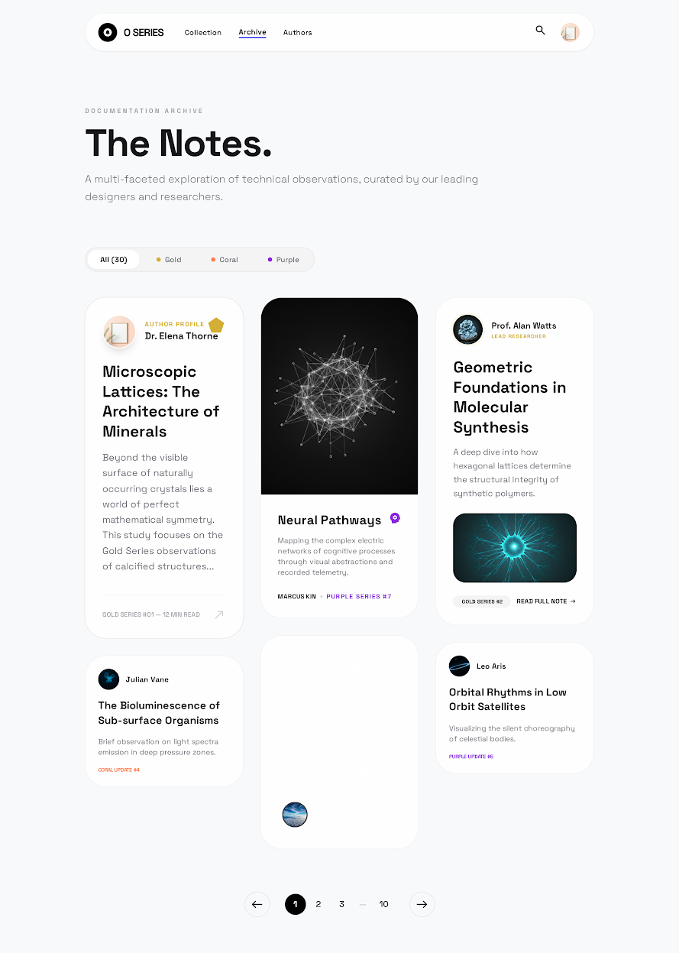
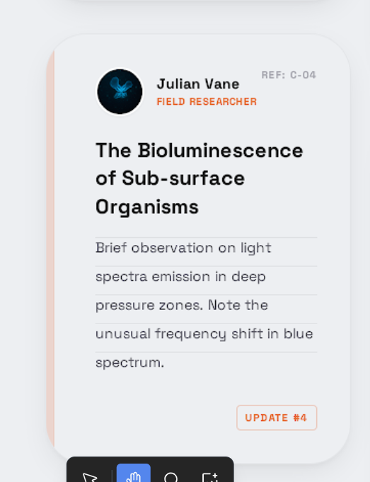
Notes page
I like this
Only make card with images, not the text one
Add this line colour in each card to distinguish them

Slide 7
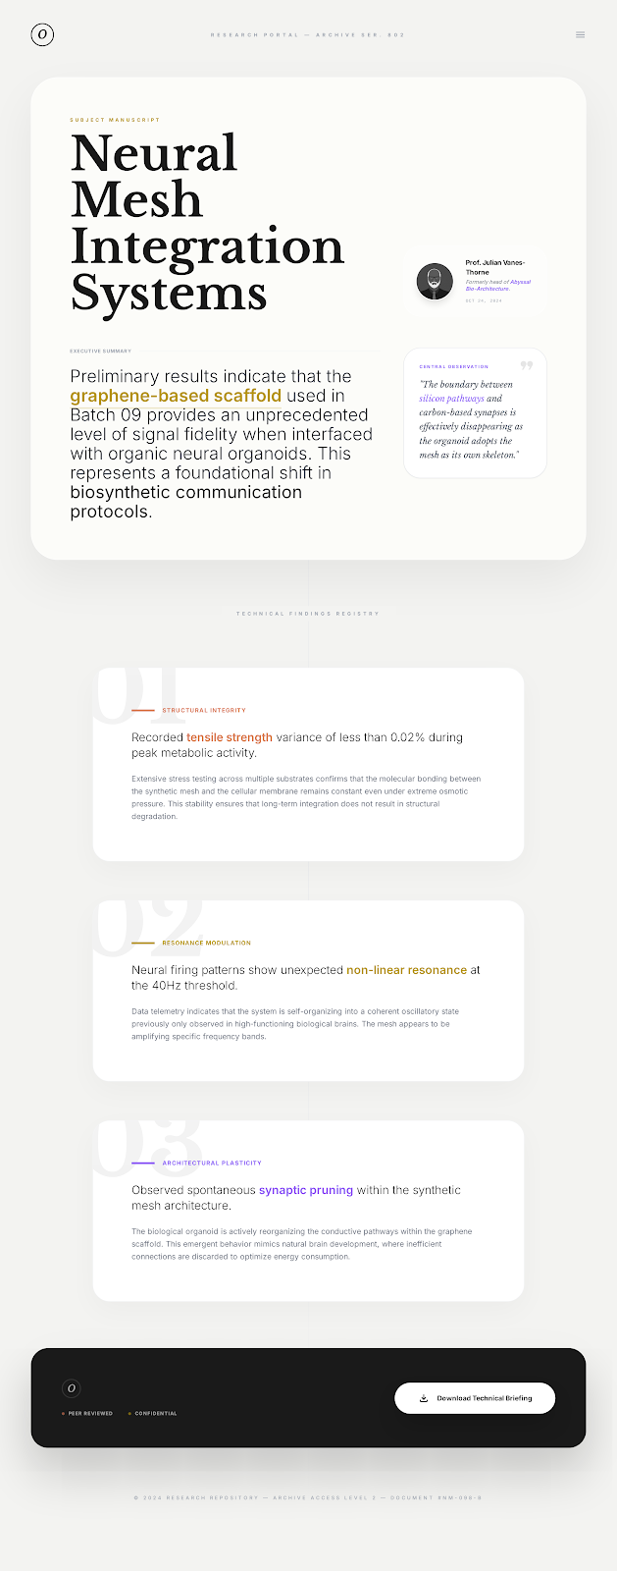
Inside the notes
The colours are earthy here, please keep, them same as other greyish blue
Title size can be decrease lil according to fitting
Prof. right hand side image will be added

Slide 8
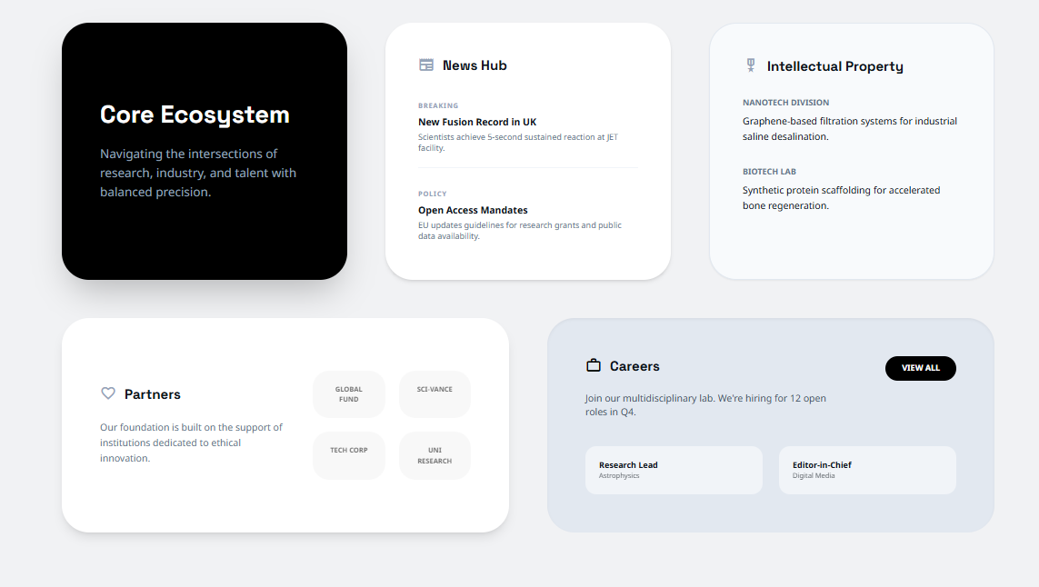
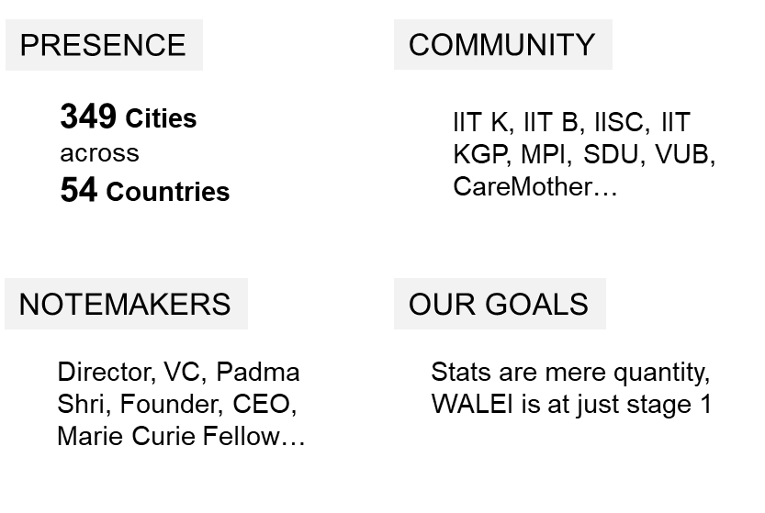

Same as this
Cascade box here
2X2
4 small boxes of different these colors
No need of these

Slide 9
ABOUT WALEI
PRESENCE
COMMUNITY
349 Cities
across
54 Countries
IIT K, IIT B, IISC, IIT KGP, MPI, SDU, VUB, CareMother…
WALEI is a digital infrastructure at stage 1 of science and innovation.
The leaps are charged by the conscience of its community. It is building of future with shear efforts by the top minds.
WALEI is about Vision, Insight and Action
NOTEMAKERS
OUR GOALS
Director, VC, Padma Shri, Founder, CEO, Marie Curie Fellow…
Stats are mere quantity,
WALEI is at just stage 1
Hey
The conversation was enlightening. It was a great opportunity and pleasure to interact with
Prof. Dipankar Chatterji, esteemed Indian Bio-scientist. A much appreciated effort by the team.
~Jayansh Deora, Subodh Public School Jaipur

Slide 10
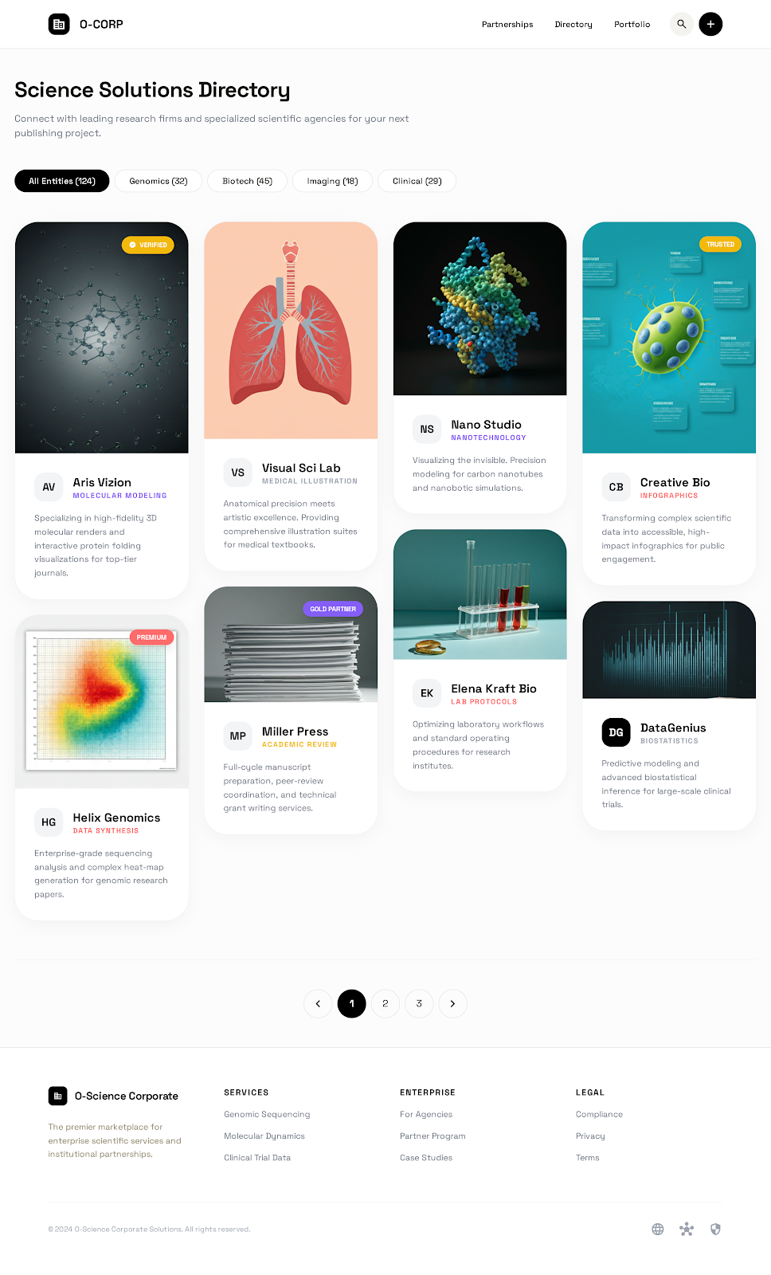
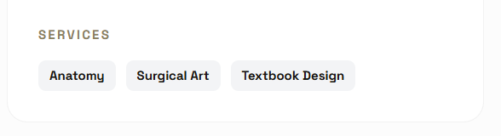
Gigs
Top as shown here, one heading and one line.
No filter, only search
Card should contain Verified tag as shown in 1st
In addition to name and some text, at bottom should contain services tags as shown at bottom
And I think same card size will be good rather variable
ROW of 3 cards

Slide 11
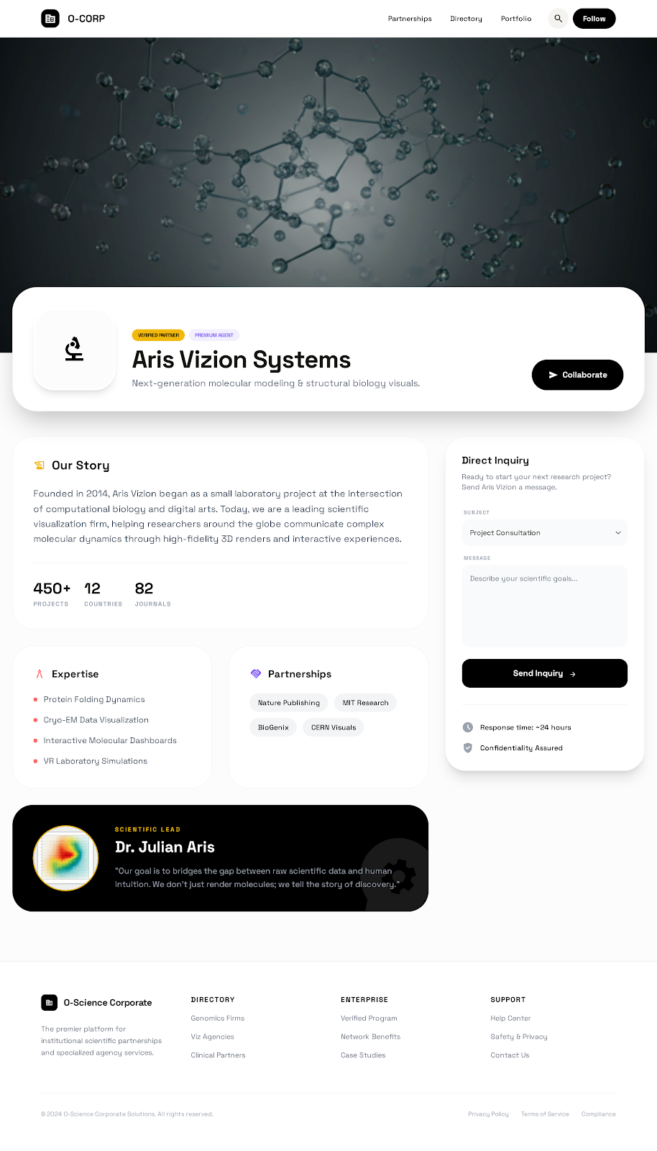
Gigs card Inside
Header height can be small and of same size as notes series
Everything same as picture
Send email in collaborate and enquiry to that gig
Use information of Sivarsa

Slide 12
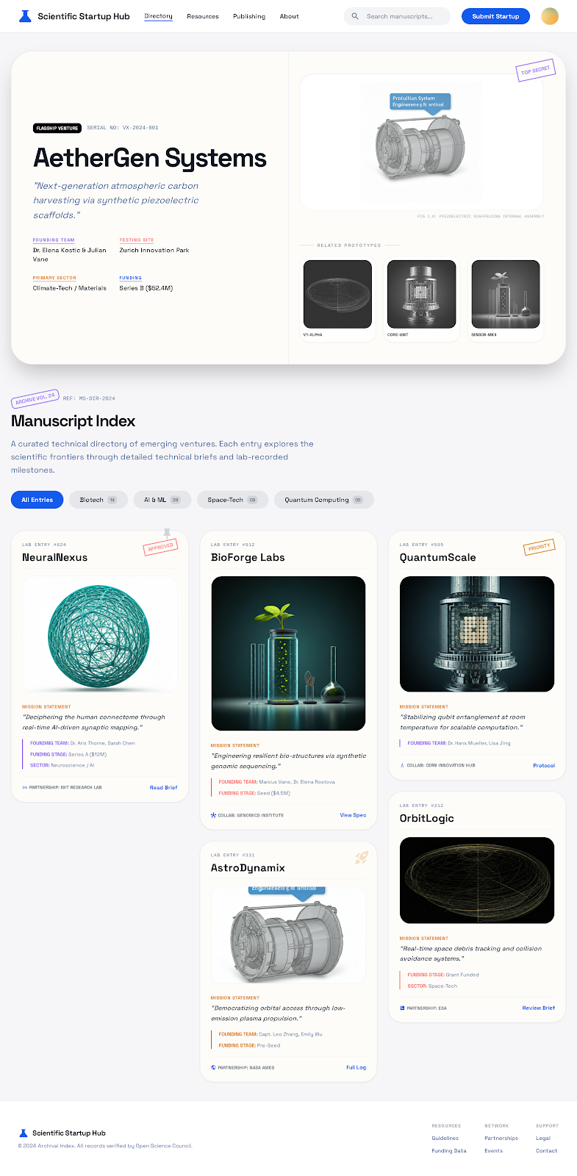
Start-up Page
Make sure the colour pallet is same every where as landing page
I don’t like earthy or brown shades, as it make the senses dull

Slide 13
Start-up card Inside
This will be similar to gig card inside.
However few additional changes are needed
A card on left showing Founders name, team size, location, link and sector
Product card inside should be placed below “our story”
Take Caremother-dotohealth for example for informations
In Product section(repository) as made (very nicely), we need care mother to be highlighted on the top

Slide 14
Patent card Inside
Again similar to gig card
List of information
Patent no. (top card)
Title (top card)
Patentee (top card)
Institution/company (New left card)
Patent duration (New left card)
Patent Jurdiction (New left card)
Abstract (Our story)
USP ( In place of Expertise)
What Kind of collaboration looking for (On top right in place of collaborate)
Tech Transfer
Joint Venture
Licensing

Slide 15
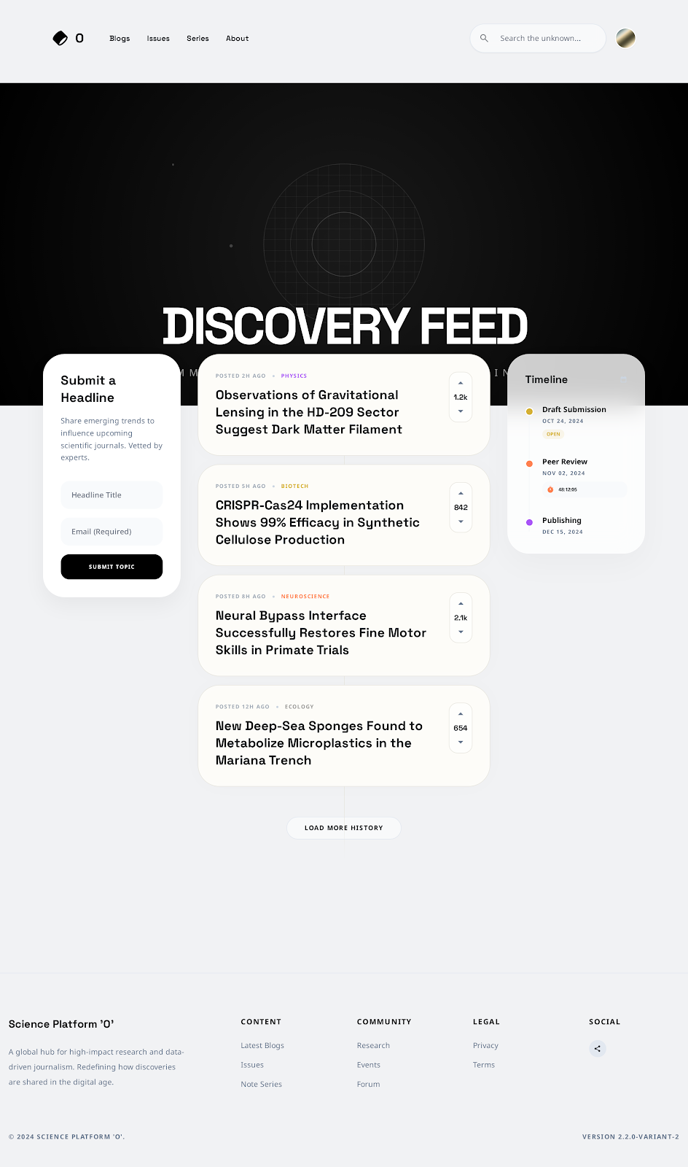
Headline & Timeline
Specific
Ask for email ID
Time stamp
30 words limit for headline
Timeline should contain date and event

Slide 16
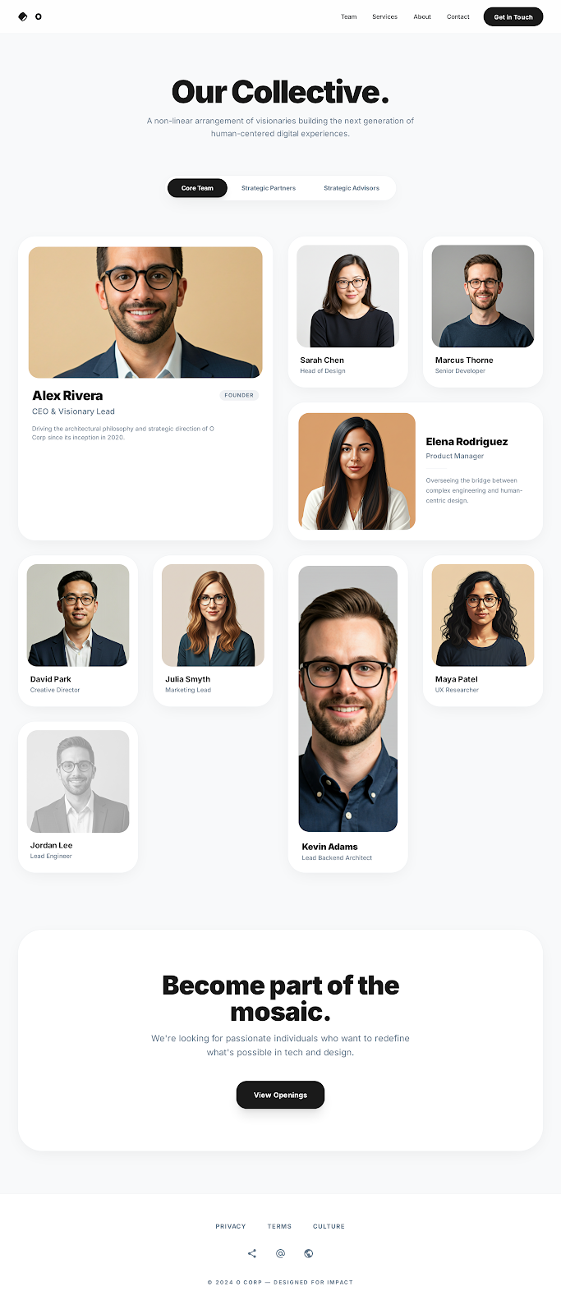
Team
Specific
Over all nice, however, card size and roundness is not nice
About Walei and join us will remain constant in advisor and strategic partner
Want a card here, to write about Walei

